Slide 1

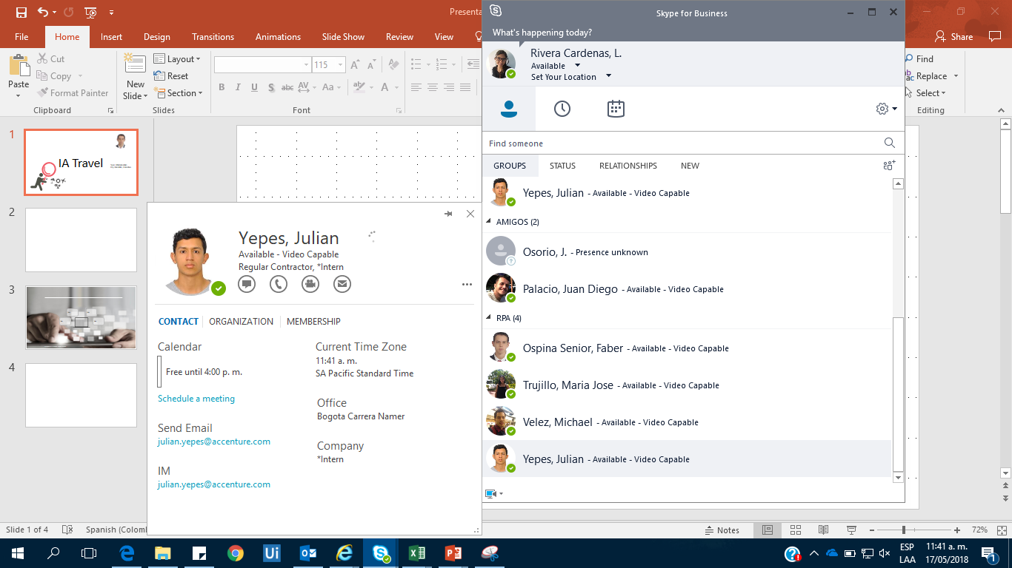
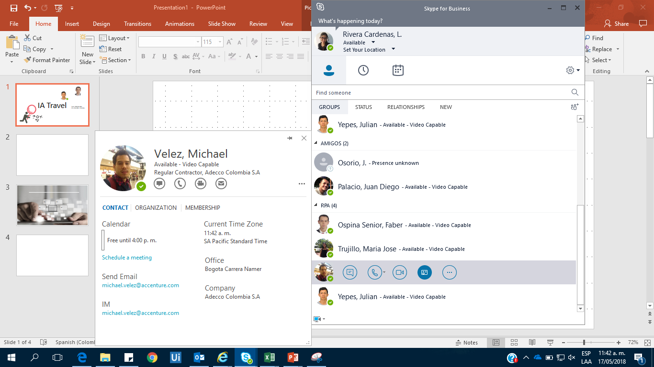
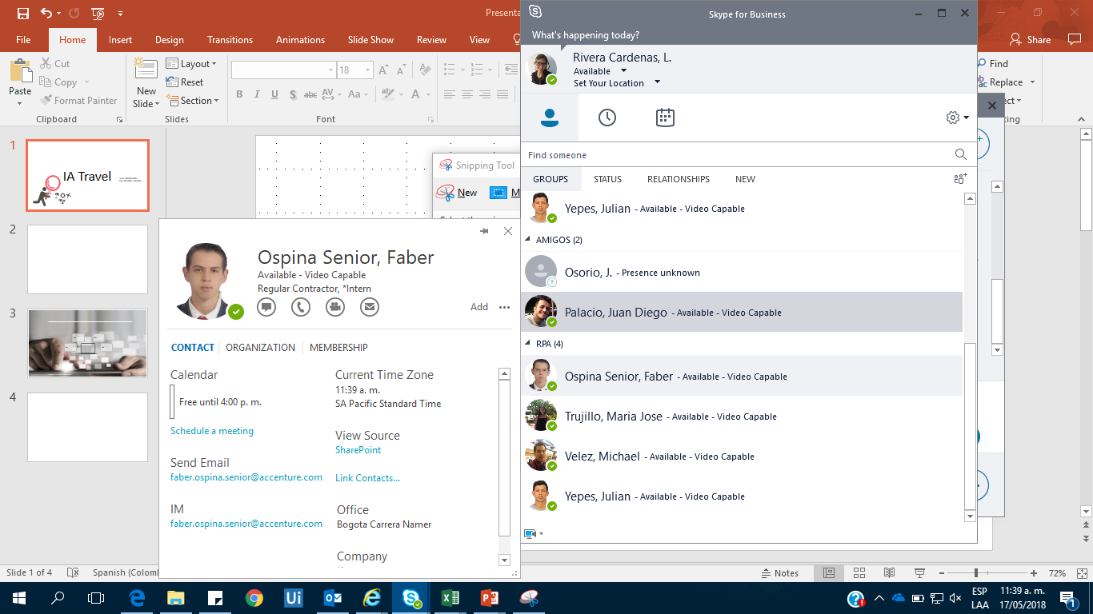
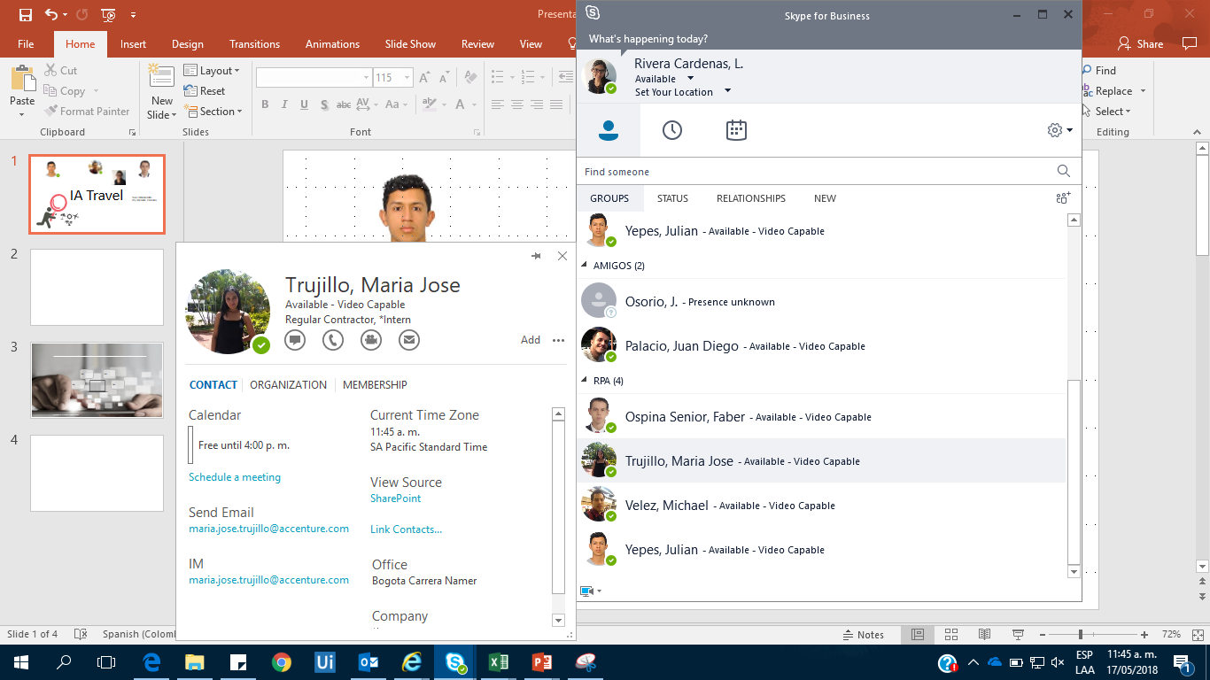
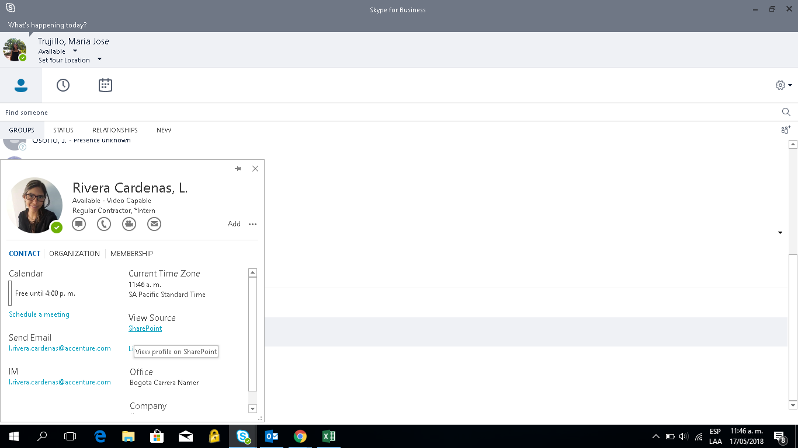

AI Travel
Julián
Michael
Faber
Maria
Fernanda
Team: RPA Medellín
City: Medellín, Colombia.
Powered by DialogFlow, TensorFlow, MySQL Database

Slide 2



User needs Tourist plans
User wants to know the best destination according to certain personal characteristics
the user interacts with the chatbot
How it works
The trained chatbot obtains demographic information from the user to obtain results.
Interact with
K-means
Chabot thinks about a good recommendation
USER
Capture necessary Information
Train the model with MySQL Database
Source Data: Demographic information
Web Page
According to the information provided, the chatbot chooses the most indicated tourist plan
Chabot gives the user the best destination
Chatbot gives to the user the best destination according to the data previously obtained.

